Slide 1

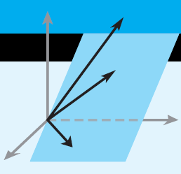
Howard Anton
Copyright © 2014 by John Wiley & Sons, Inc.
All rights reserved.
Chapter 4
Page 169

Slide 2
Chapter 4 General Vector Spaces
4.1 Real Vector Spaces
4.2 Subspaces
4.3 Linear Independence
4.4 Coordinates and Basis
4.5 Dimension
4.6 Change of Basis
4.7 Row Space, Column Space, and Null Space
4.8 Rank, Nullity, and the Fundamental Matrix Spaces
4.9 Matrix Transformations from R^{n} to R^{m}
4.10 Properties of Matrix Transformations
4.11 Geometry of Matrix Operators on R²
4.12 Dynamical Systems and Markov Chains
Page 214

Slide 3
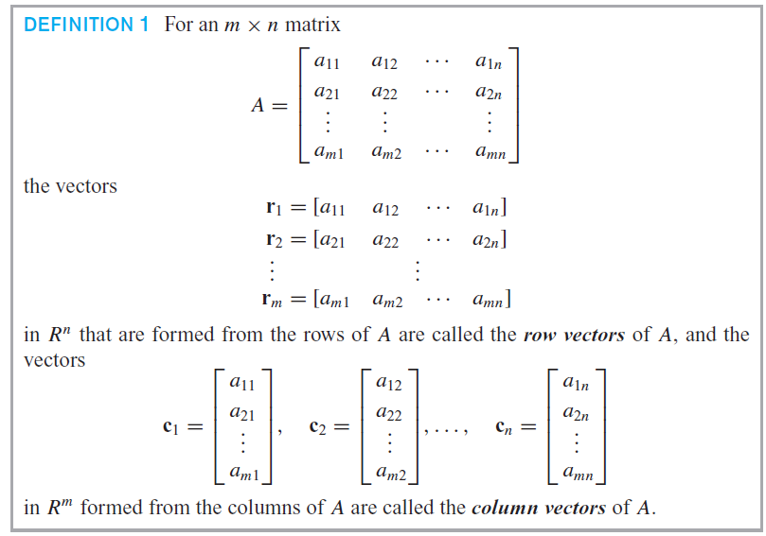
Section 4.7 Row Space, Column Space, and Null Space
Page 214
are row vectors in

Slide 4
Section 4.7 Row Space, Column Space, and Null Space

Slide 5

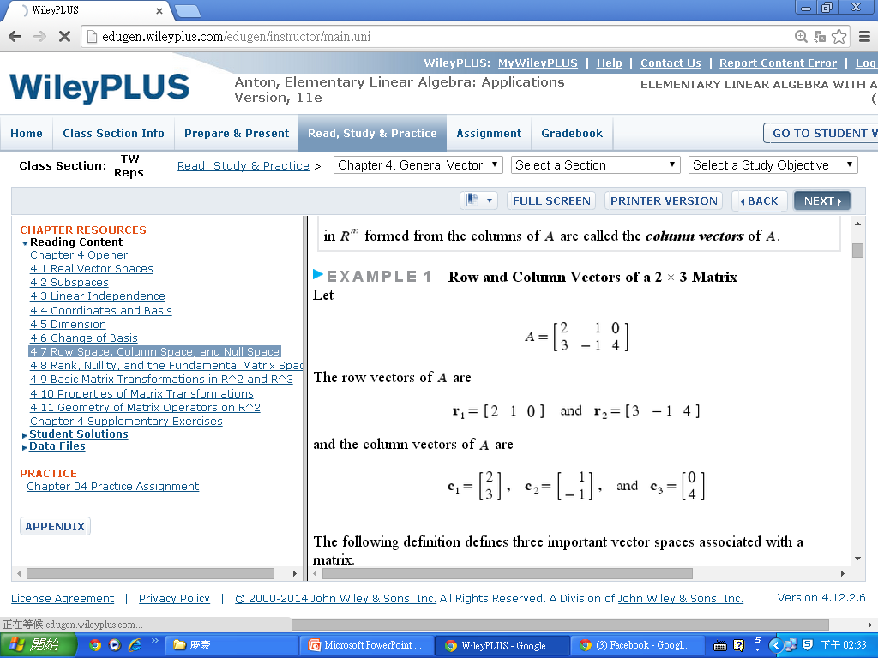
Section 4.7 Row Space, Column Space, and Null Space

Slide 6
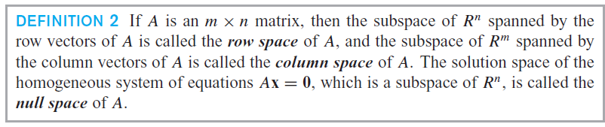
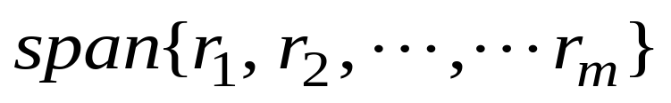
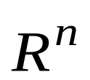
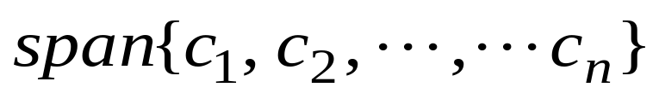
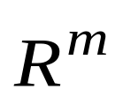
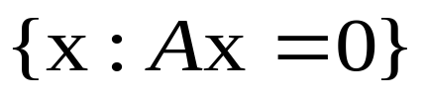
Section 4.7 Row Space, Column Space, and Null Space
Row space of A =
is a subspace of
Column space of A =
is a subspace of
Null space of A =
is a subspace of

Slide 7

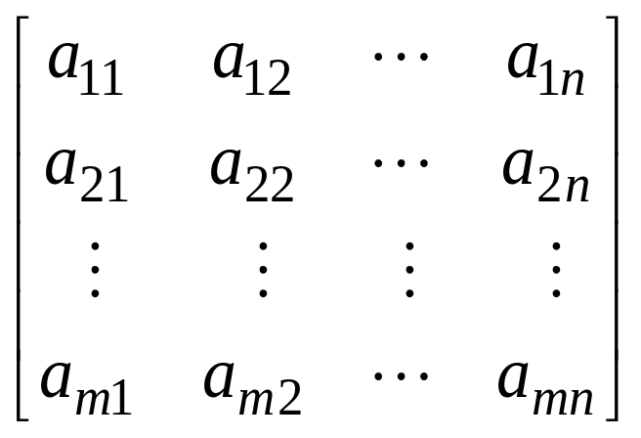
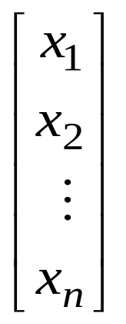
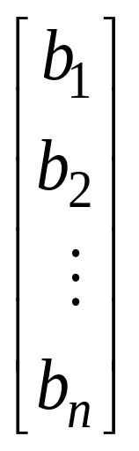
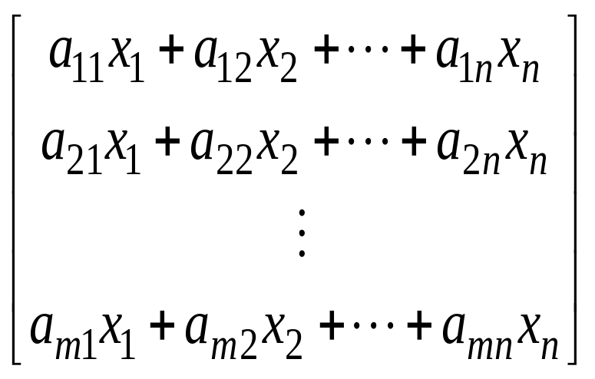
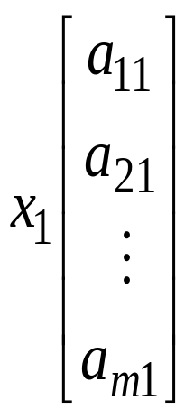
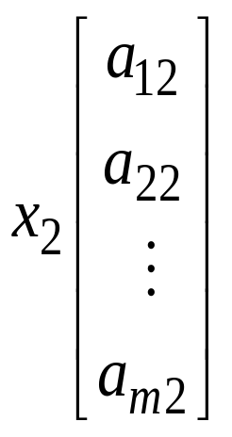
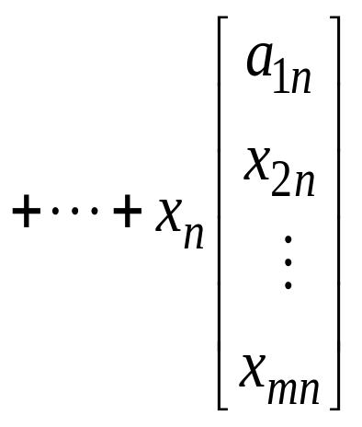
Section 4.7 Row Space, Column Space, and Null Space
x =
b =
Ax =
=
+
=

Slide 8
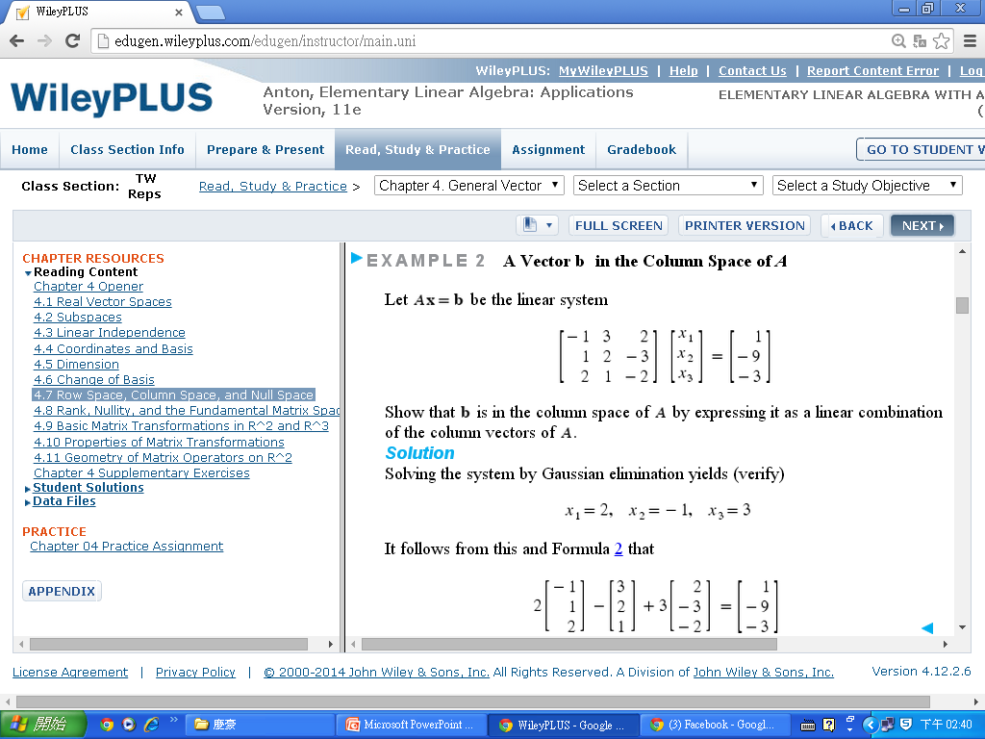
Section 4.7 Row Space, Column Space, and Null Space

Slide 9
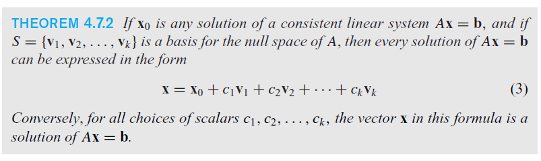
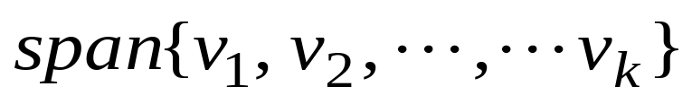
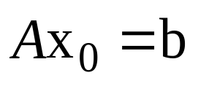
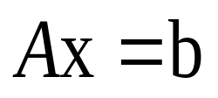
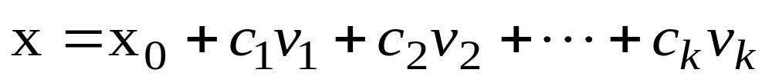
Section 4.7 Row Space, Column Space, and Null Space
Page 216
Null space of A =
=

Slide 10
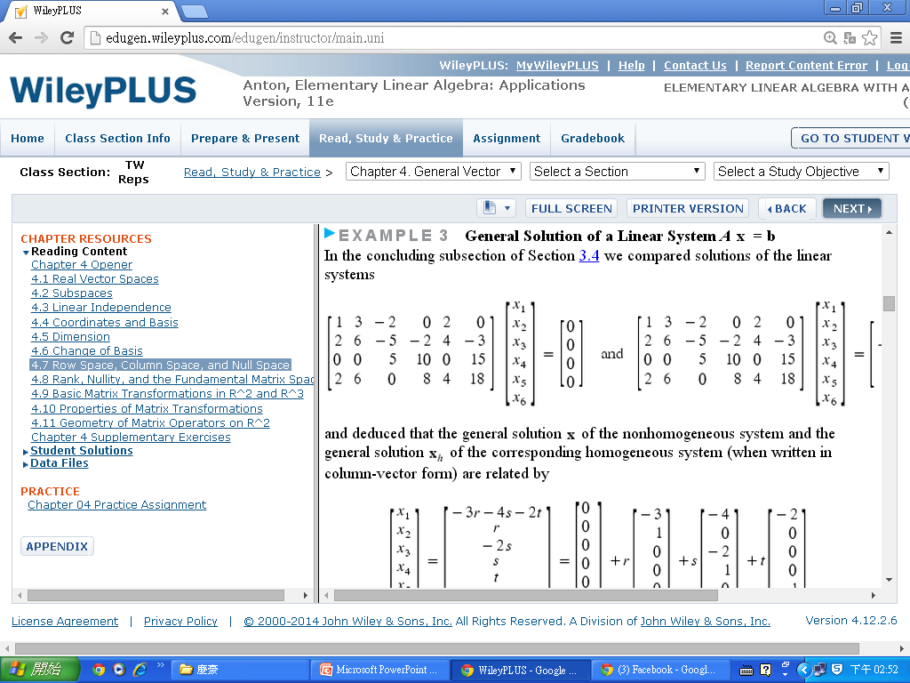
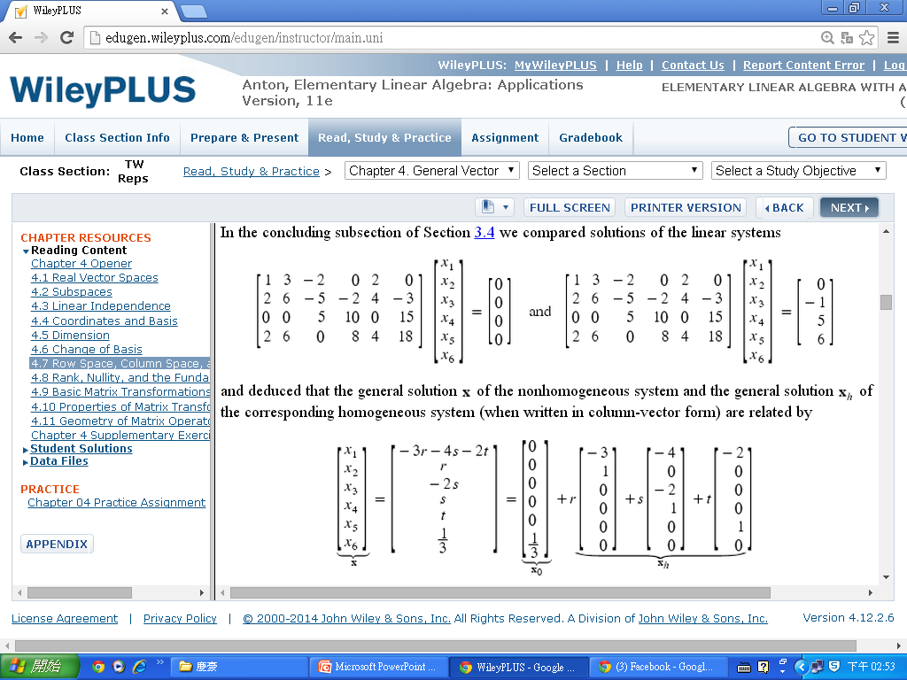
Section 4.7 Row Space, Column Space, and Null Space

Slide 11
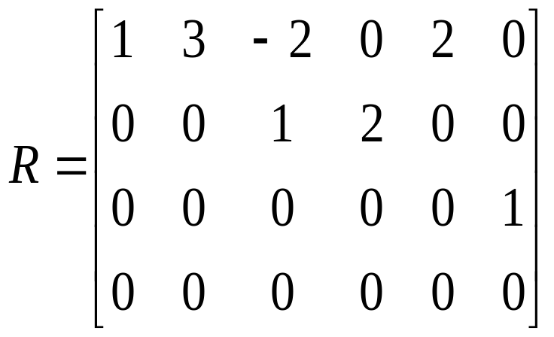
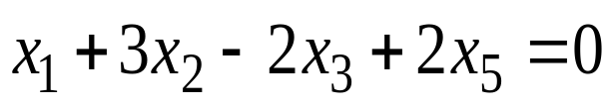
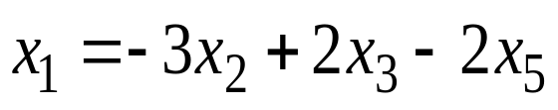
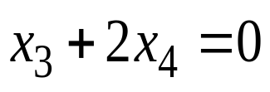
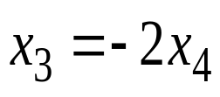
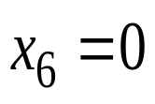
Section 4.7 Row Space, Column Space, and Null Space

Slide 12
Section 4.7 Row Space, Column Space, and Null Space
Example 4,
Page 218

Slide 13
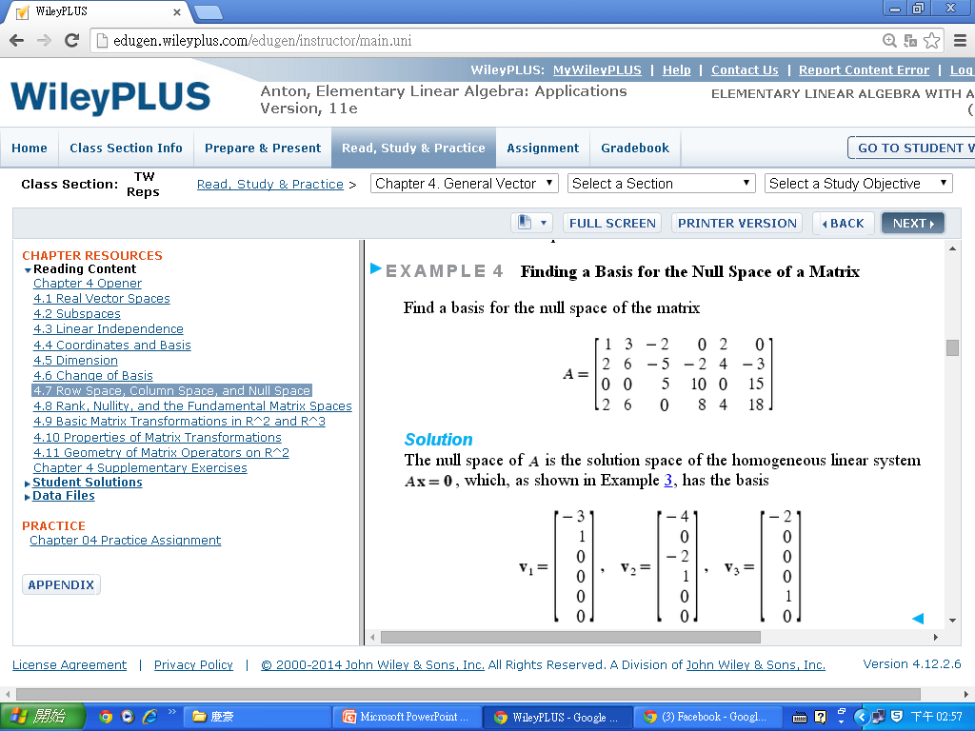
Section 4.7 Row Space, Column Space, and Null Space

Slide 14
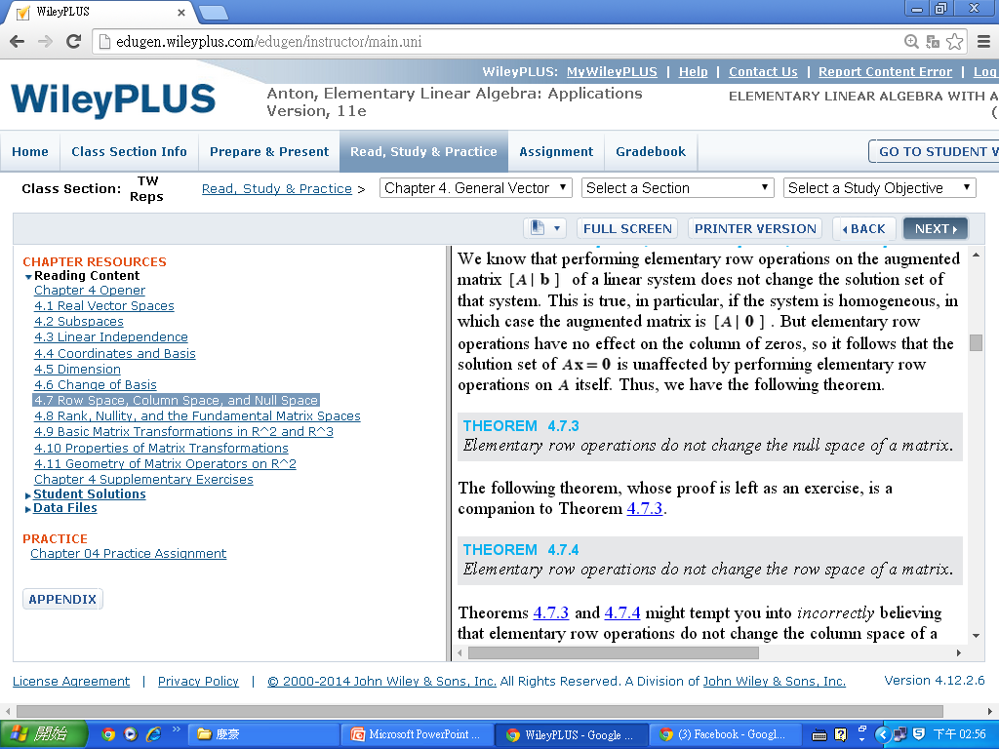
Section 4.7 Row Space, Column Space, and Null Space
Performing an elementary row operation on an augmented matrix does not change the solution set of the corresponding linear system.

Slide 15
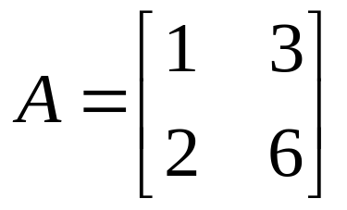
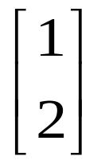
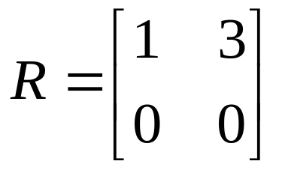
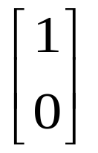
Section 4.7 Row Space, Column Space, and Null Space
We just learned from the elementary row operations do not change the row space of a matrix. However, the elementary row operations do change the column space of a matrix.
For instance, let
Column space of A =
Column space of R =

Slide 16
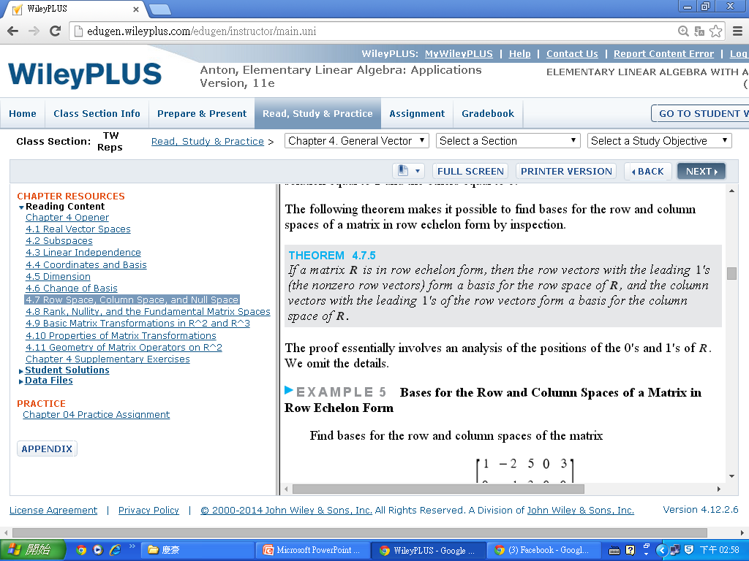
Section 4.7 Row Space, Column Space, and Null Space

Slide 17
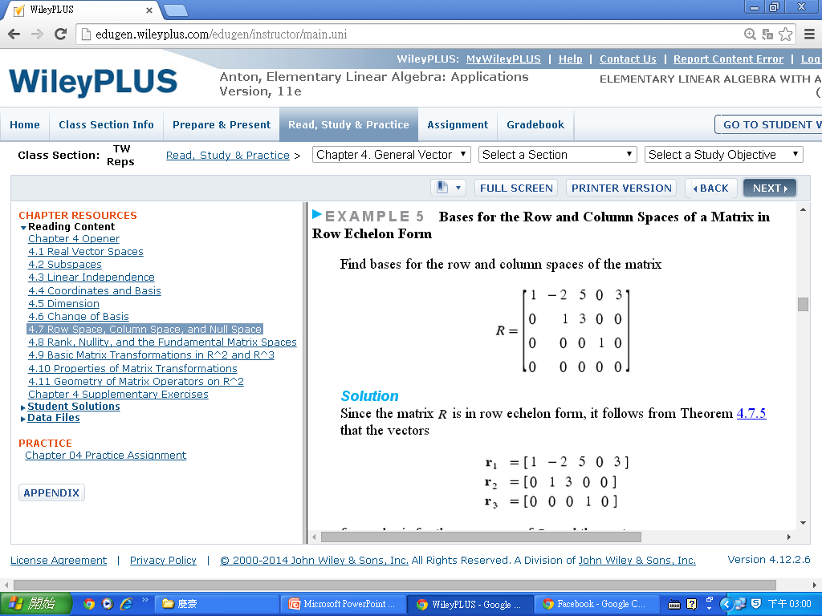
Section 4.7 Row Space, Column Space, and Null Space

Slide 18
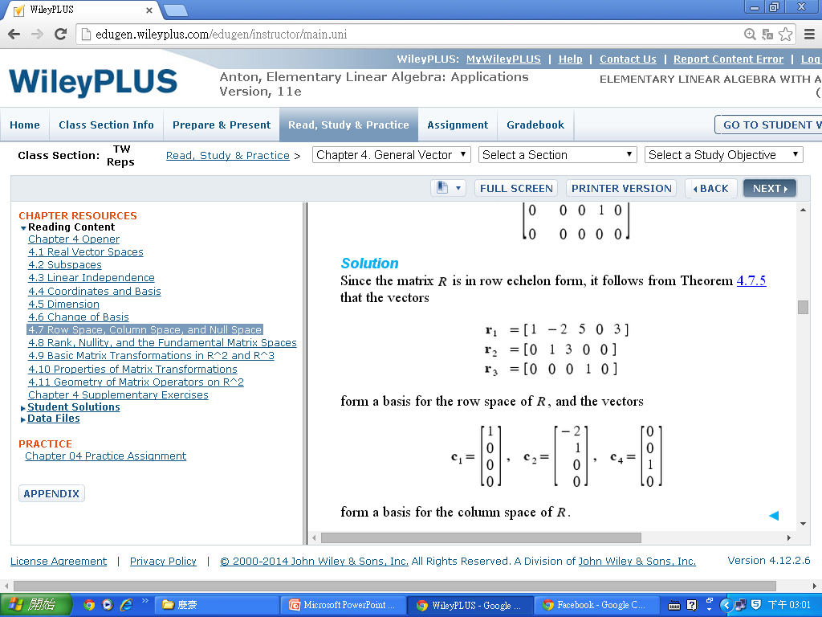
Section 4.7 Row Space, Column Space, and Null Space
Example 5

Slide 19
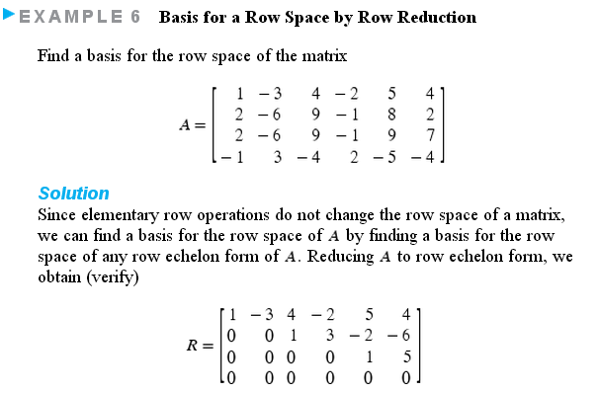
Section 4.7 Row Space, Column Space, and Null Space

Slide 20
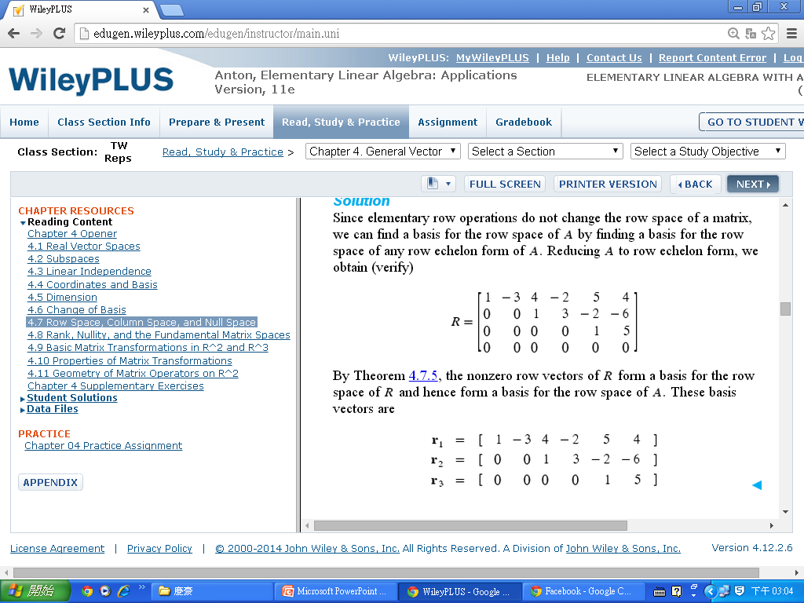
Section 4.7 Row Space, Column Space, and Null Space
Example 6

Slide 21
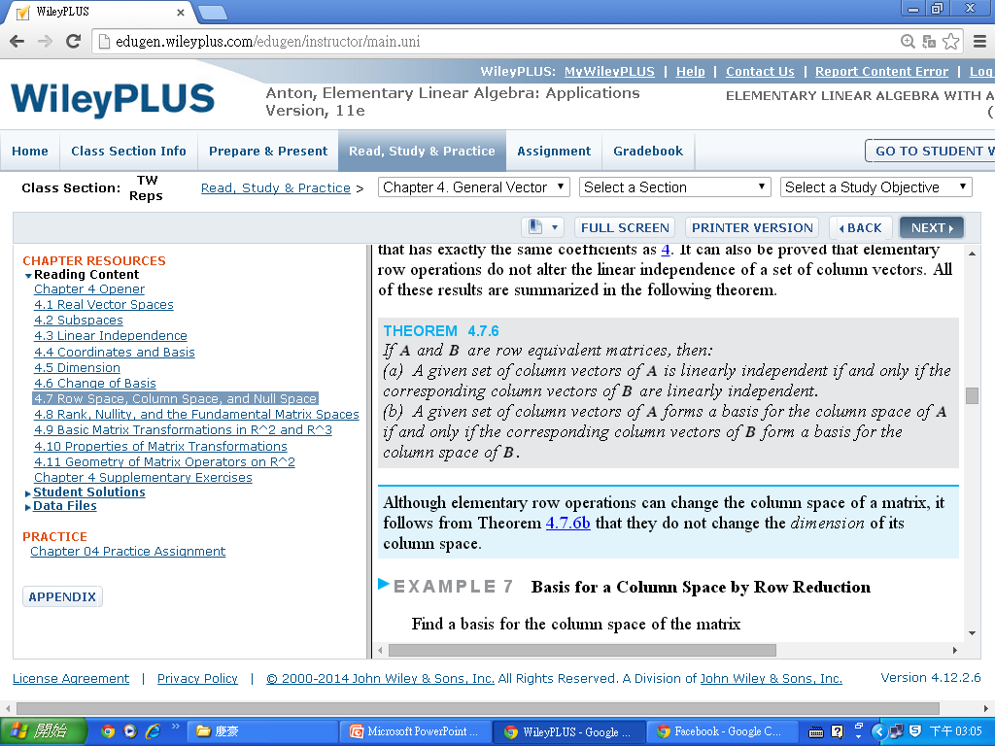
Section 4.7 Row Space, Column Space, and Null Space

Slide 22
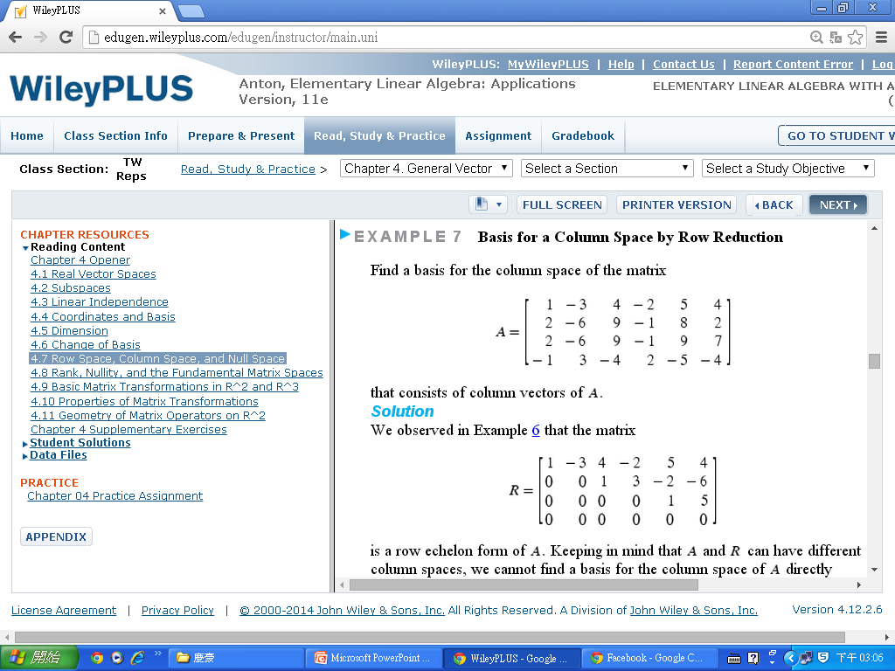
Section 4.7 Row Space, Column Space, and Null Space

Slide 23
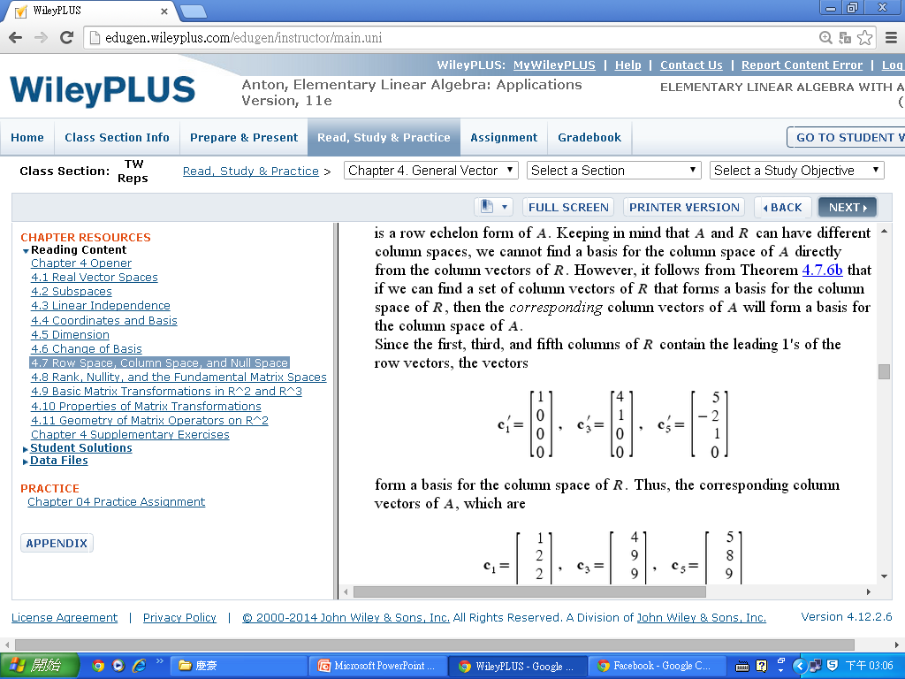
Section 4.7 Row Space, Column Space, and Null Space
Example 7

Slide 24
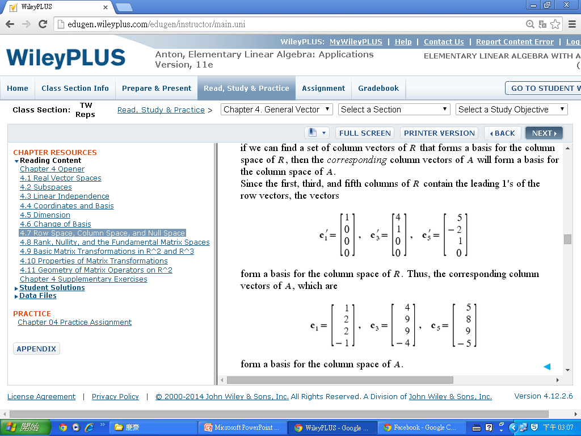
Section 4.7 Row Space, Column Space, and Null Space
Example 7

Slide 25
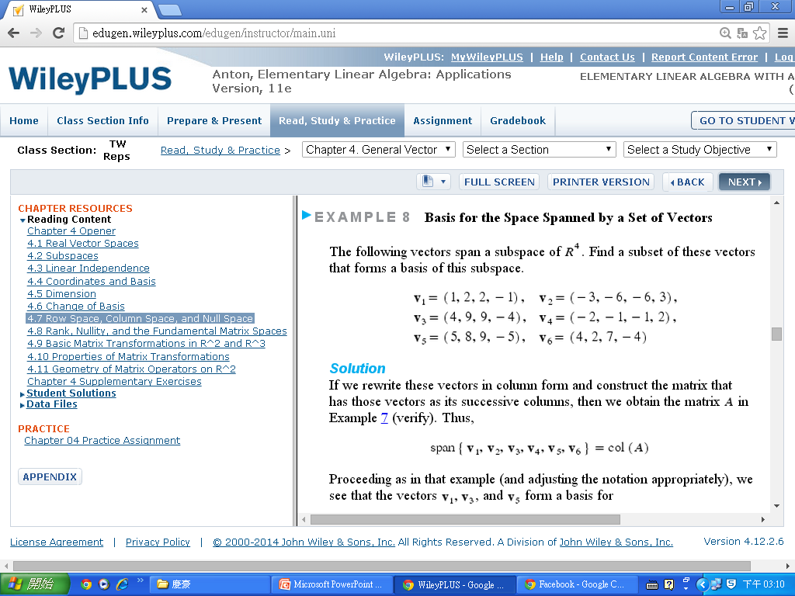
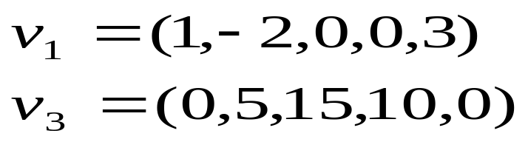
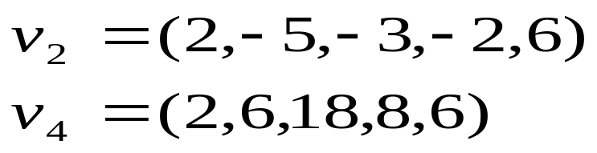
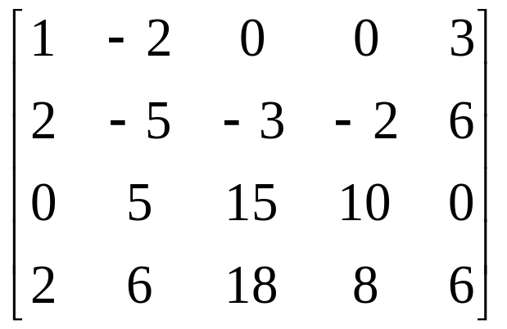
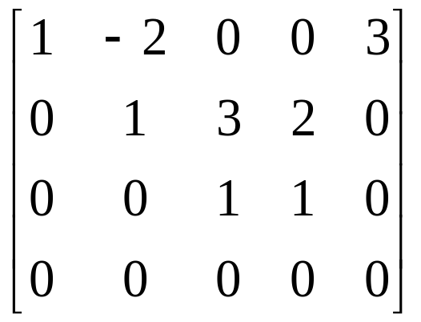
Section 4.7 Row Space, Column Space, and Null Space
Find a basis for the subspace of R⁵ spanned by the vectors
Solution
The space spanned by these vectors is the row space of the matrix

Slide 26




Section 4.7 Row Space, Column Space, and Null Space
Reducing this matrix to row echelon form, we obtain
The nonzero row vectors in this matrix are
These vectors form a basis for the row space and consequently form a basis for the subspace of R₅ spanned by v₁, v₂, v₃ and v₄.

Slide 27



Section 4.7 Row Space, Column Space, and Null Space
Find a basis for the row space of
Consisting entirely of row vectors from A.
Solution We will transpose A, thereby converting the row space of A into the column space of A^{T}; then we will use the method of Example 7 to find a basis for the column space of A^{T}; and then we will transpose again to convert column vectors back to row vectors. Transposing A yields
Step 1.

Slide 28


Section 4.7 Row Space, Column Space, and Null Space
Example 9
Reducing this matrix to row echelon form yields
The first, second, and fourth columns contain the leading 1’s, so the corresponding column vectors in A^{T} form a basis for the column space of A^{T} ; these are
Step 2.
Step 3.

Slide 29

Section 4.7 Row Space, Column Space, and Null Space
Example 9
Step 4.
Transposing again and adjusting the notation appropriately
yields the basis vectors
for the row space of A.

Slide 30


Section 4.7 Row Space, Column Space, and Null Space

Slide 31


Section 4.7 Row Space, Column Space, and Null Space

Slide 32
Section 4.7 Row Space, Column Space, and Null Space

Slide 33
Homework
Sec. 4.7
# True/False
Page 224
# 131 (b) (e)
Page 279
# 134 (c) (d) (e)
# 135 (c)
# 136 (c) (d)
# 146

